Slide 1
Welcome
to Our
Presentation!

Slide 2

Presented by Team Elite
Members Name: ID No:
1)Farhana Hossain 17183103033
2) Naznin Nahar Akhi 17183103001 3) Fatema-Tuz Zohra 17183103009 4)Syeda Nowshin Ibnat 17183103020
Dept. of Computer Science and Engineering
Intake-39(Sec-1)

Slide 3
Our Topics:
1)Zero Energy Building
2)LED Lighting for Energy Efficiency
3)Paper Battery

Slide 4
Contents:
Introduction
Principles
Applications
Advantages
Disadvantages
Future aspects
References

Slide 5
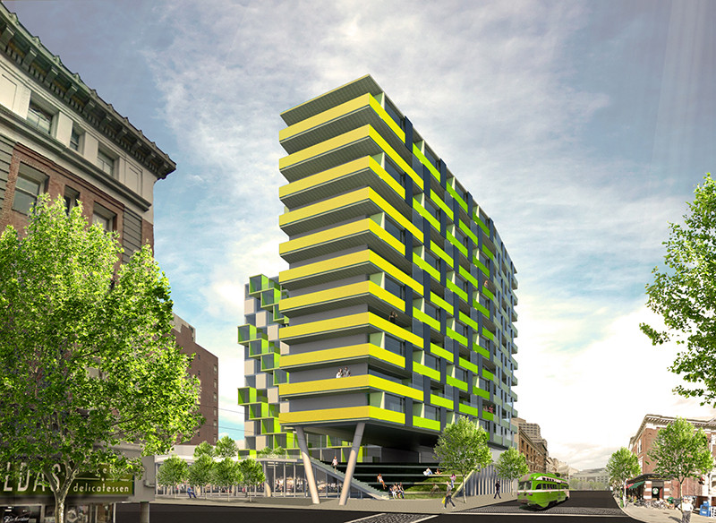
Zero Energy Building
Introduction:
A Zero Energy Building is a building with zero net energy consumption.
It Generates more energy than consumes.

Slide 6
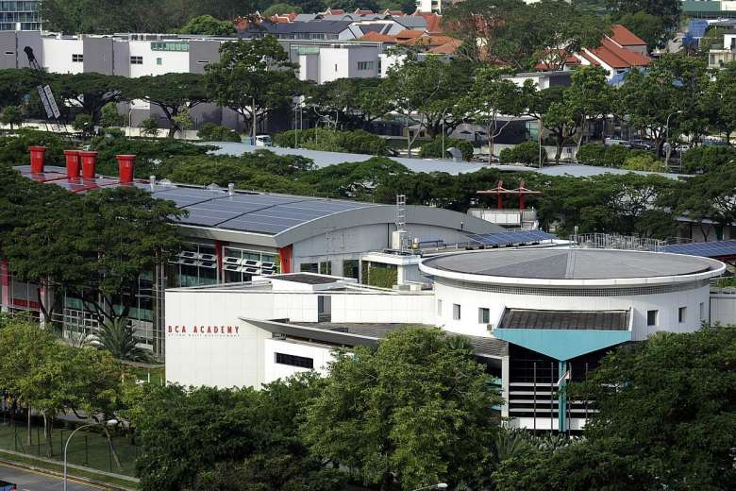
These Buildings contribute less overall greenhouse gases to the atmosphere than a similar non-zero-energy building.
Reduce carbon emission and dependence on fossil fuels which is the zero-net-energy consumption principle.

Slide 7

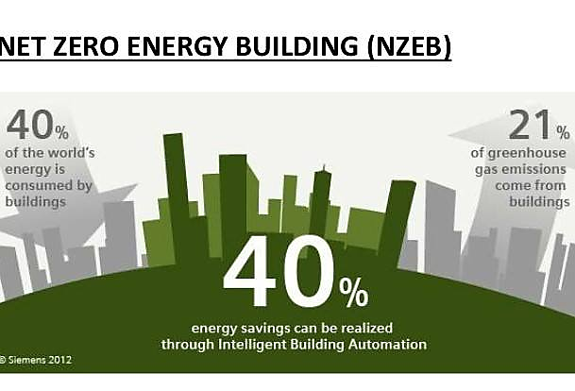

Slide 8
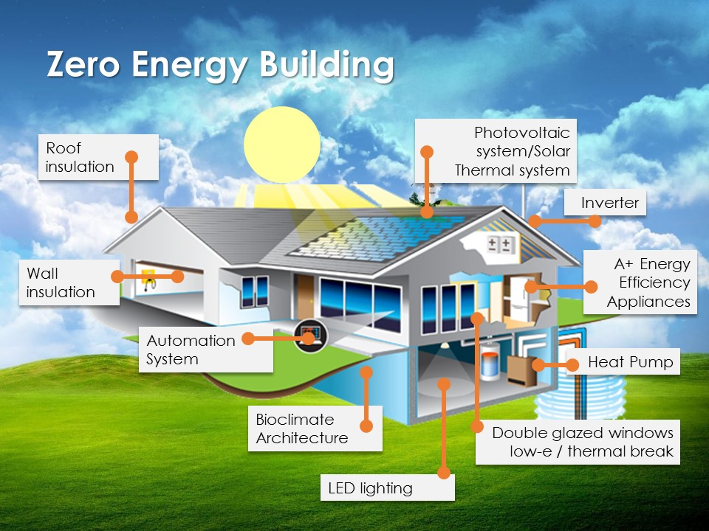
Principle:
Design & Construction:
Building Design: Walls, floors and windows distribute heat during winter and reject the solar heat during summer.

Slide 9
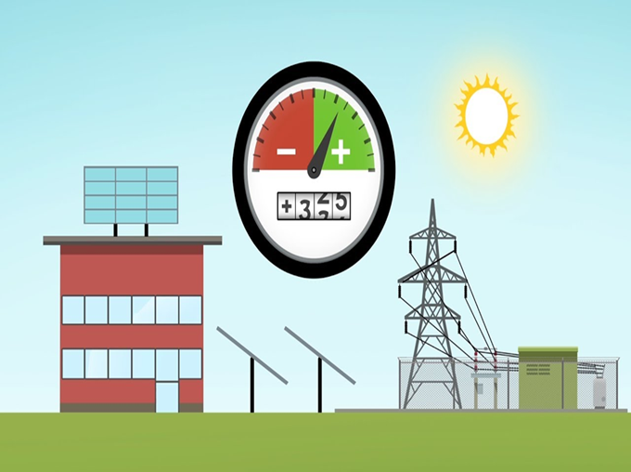

The Site: Choosing a site with the necessary assets and knowing about its limitations.
More Exposure to Sunlight: Zero energy should be designed in such way that more Sun Rays can be used so that it can generate more energy.

Slide 10
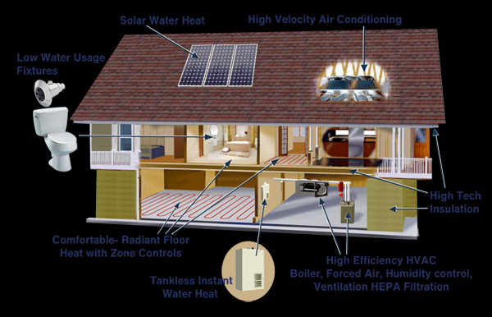
Energy Saving Features: Includes heating and cooling loads, insulation and ventilation depending on climate zones.

Slide 11
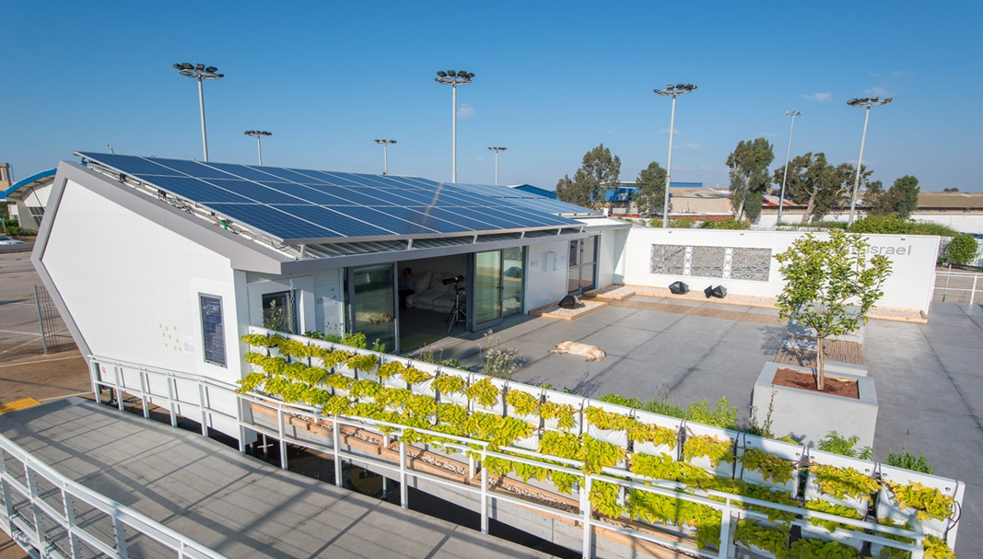
Solar Energy: Solar panels placed on the rooftop absorbing as much of the energy from the sunlight. The energy can be used for cooking, heating ,etc.

Slide 12
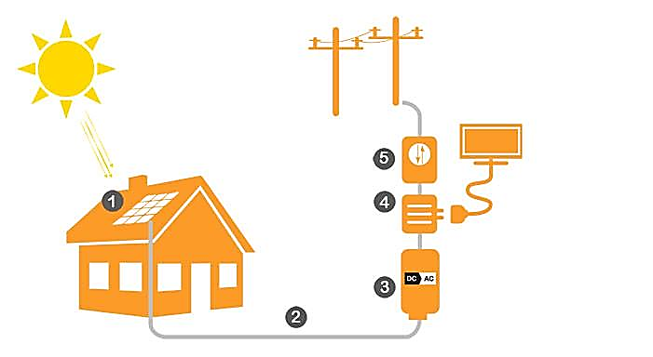

Slide 13
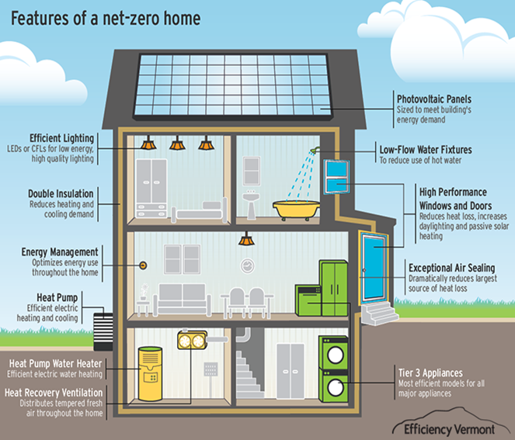
Applications:
ZEB improve the value of the property and promote the health and wellbeing of occupants.
ZEBs are 60-90% over energy efficiency baselines.
Here,ZEB=Zero Energy Building

Slide 14
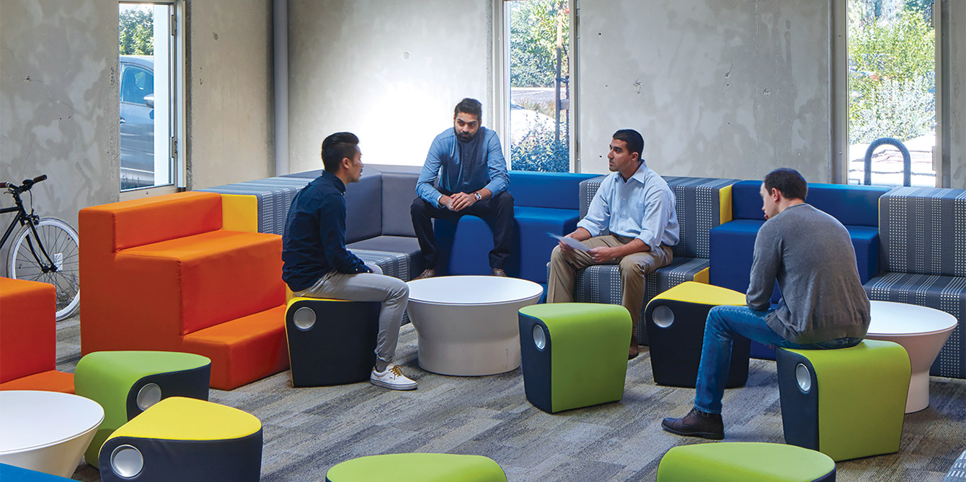
Anyone involve during the design, construction, operations serves to gain valuable knowledge about zero-energy.

Slide 15

Energy can’t be created
But it can be destroyed
So save it!

Slide 16
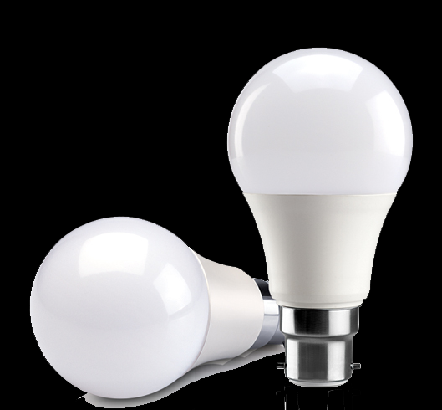
LED Lighting for Energy Efficiency
Introduction:
A light emitting diode(LED) is a special type of semiconductor.
LED consumes far less energy than standard light bulbs and tubes.
The typical working life of an LED light is 11.2 years.

Slide 17
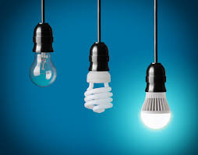
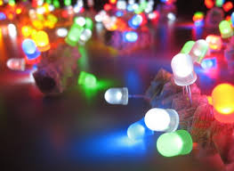
In early 1990’s high brightness LED packages were developed and widespread.
White LED were produced in 1993.
Now LED lightening is a rapidly growing technology that produces a light in a new way.

Slide 18
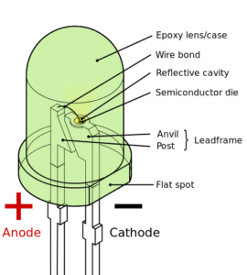
Principle:
LED (Light Emitting Diode) is basically a small light emitting device that comes under “active” semiconductor electronic
components.
Two lead semiconductor light source.

Slide 19
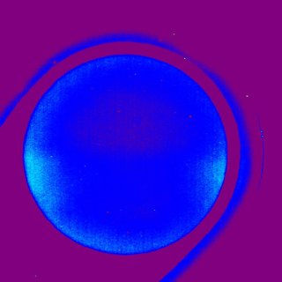
The material used in LEDs is basically aluminum-gallium-arsenide (AlGaAs).
The atoms of this material are strongly bonded.

Slide 20
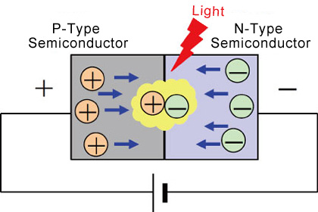
When P-N junction diode is forward based an electron may fell into hole and releasing some energy.
This energy is in the form photon and hence light is emitted.

Slide 21
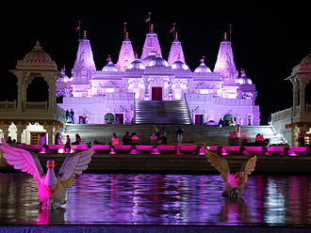
Applications:
Where colored light is needed, LED inherently emit light of a single color require no energy-absorbing filters.
It is perfect to use in a area where maintenance is difficult.

Slide 22
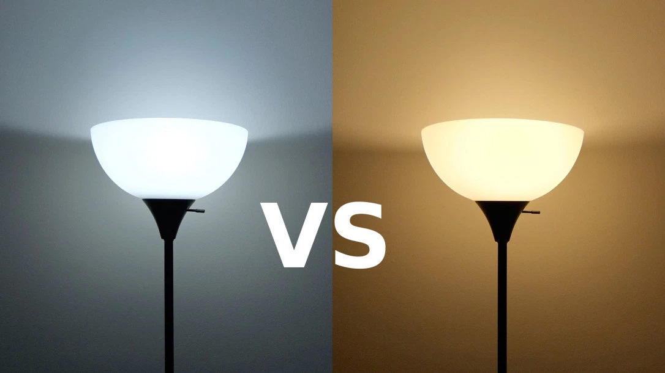
White-light LED lamps have longer life expectancy than most other lighting.
It can be use in outdoor wall and ceiling mounted area illumination.

Slide 23
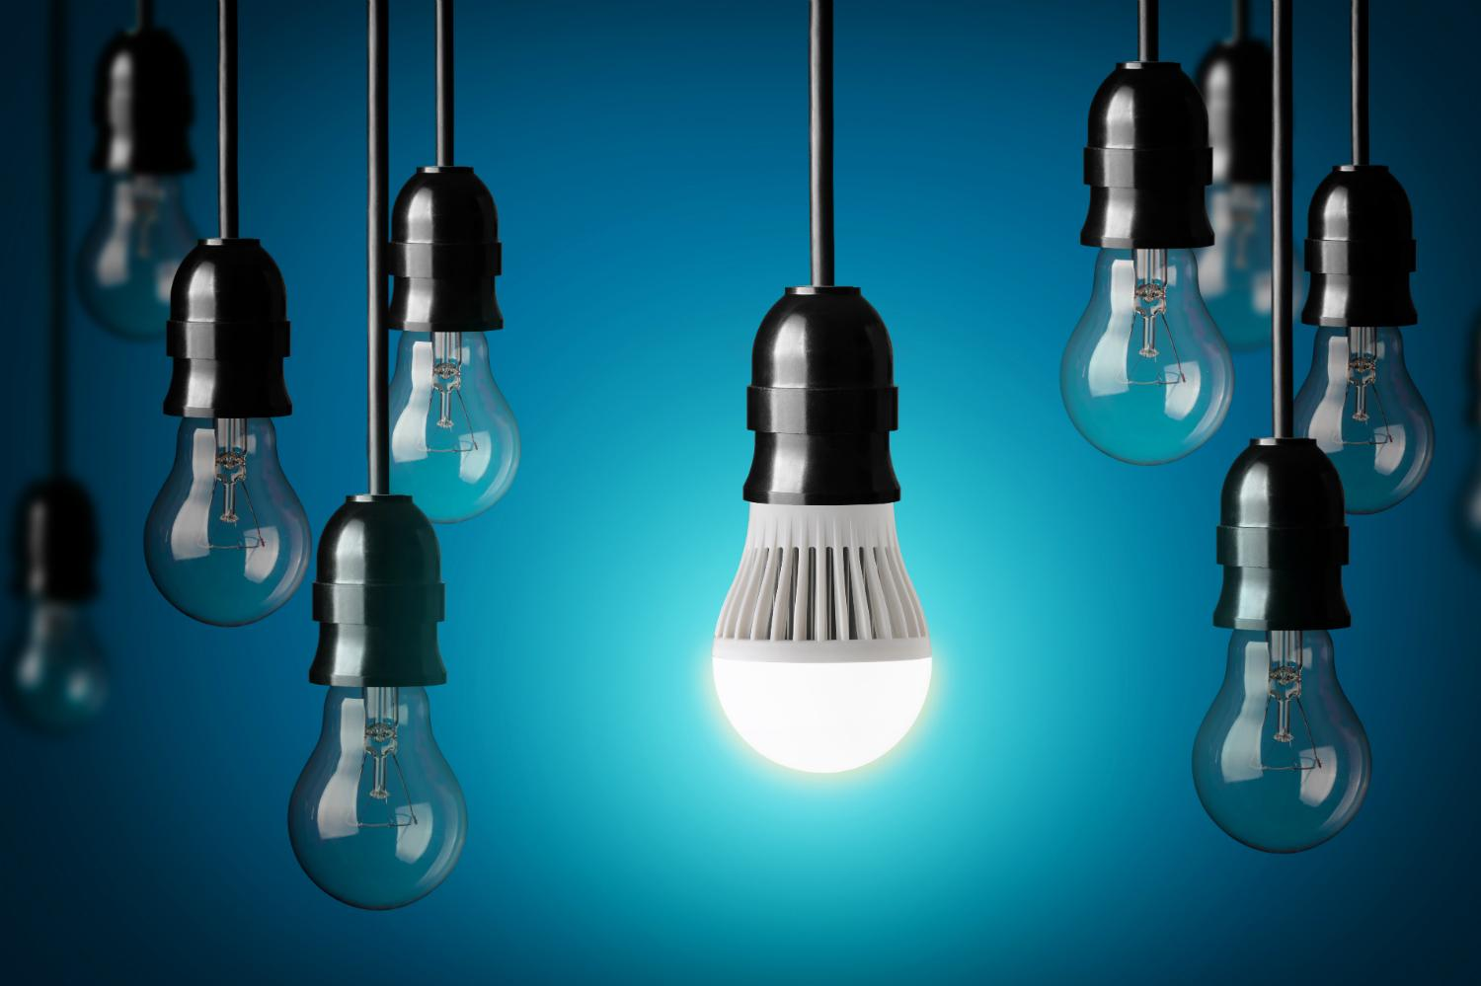
Change a light,
Change the world.
Save Electricity.

Slide 24
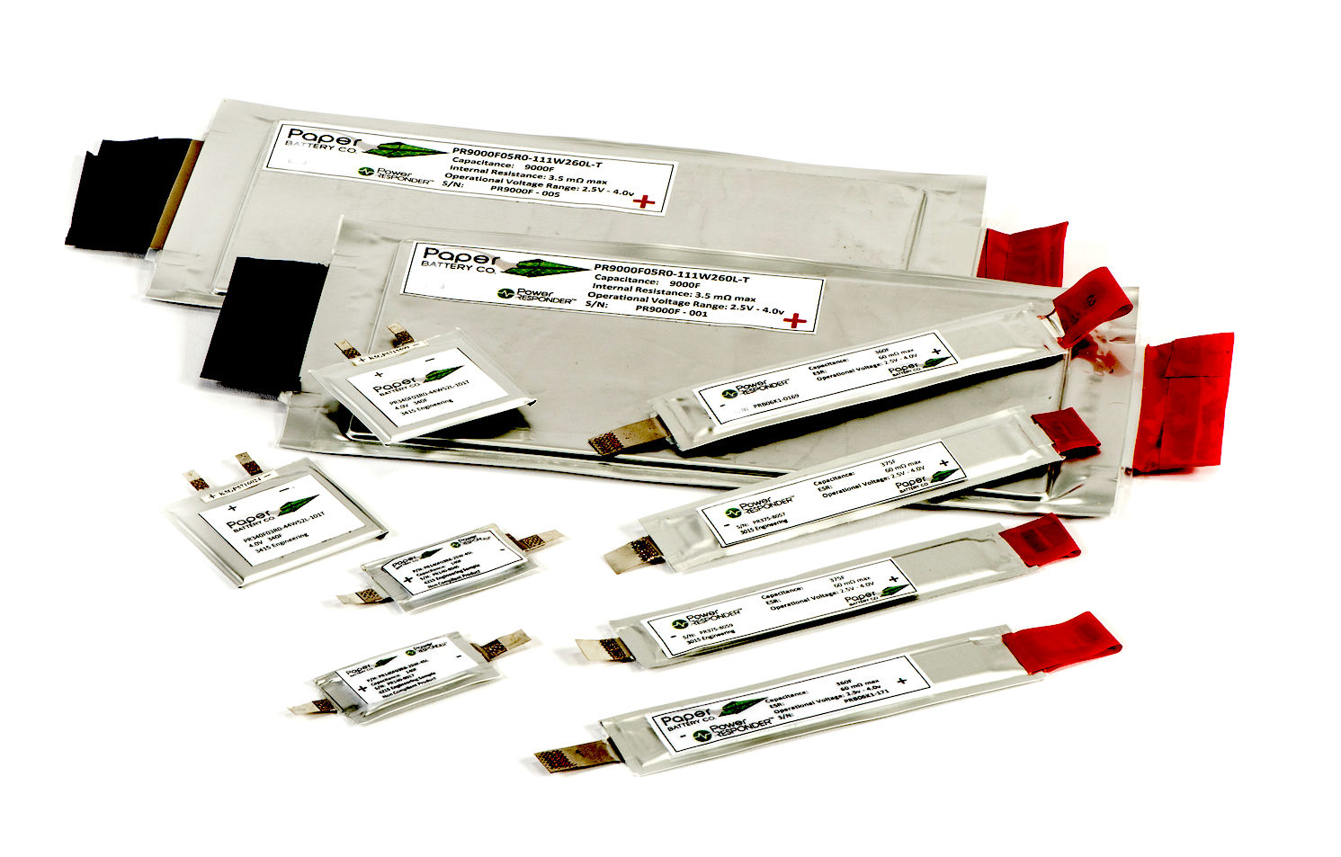
Paper Battery
Introduction:
Paper battery(PB)=Paper + Nano Technology
Paper battery is a flexible, ultra-thin energy storage and production device.

Slide 25
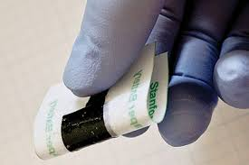
In august 2007, A research team at Rensselear polytechnic institute developed the paper battery, also known as Nano composite paper.

Slide 26
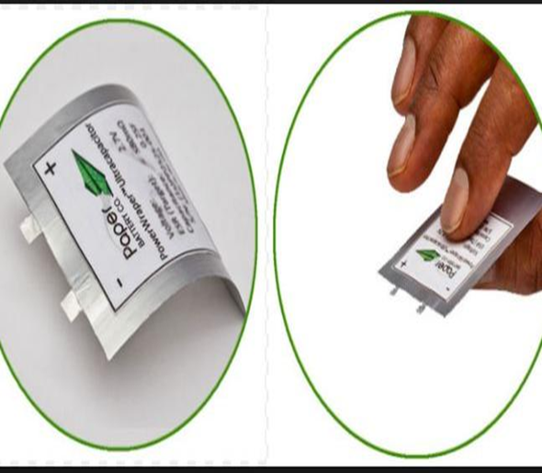
It act as high energy battery and
super capacitor due to combining
of two discrete components that are separate in traditional electronics.

Slide 27
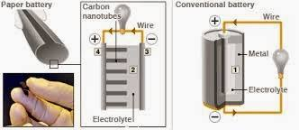
Principle:
Paper battery made of
carbon Nano tubes and paper or cellulose.
The functioning of paper Batteries
is similar to that of a Conventional battery.

Slide 28
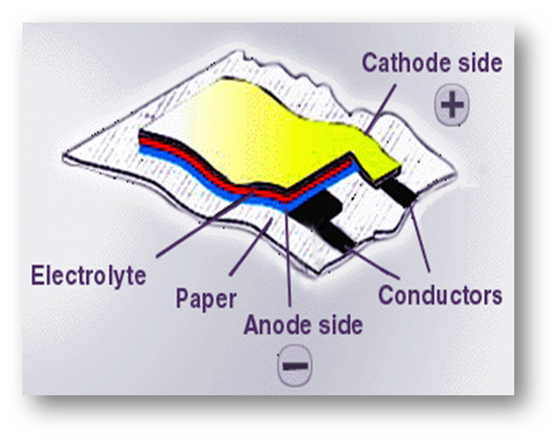
Paper battery Contains
Cathode: Carbon Nanotube.
Anode: Lithium metal (Li+)
Electrolyte: bio electrolytes like urine, blood and sweat. ( All electrolytes can be used)
Separator: Cellulose or Paper.

Slide 29
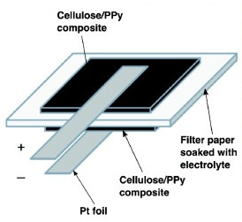
The carbon nanotubes are embedded in a sheet of paper soaked in ionic liquid electrolytes which conduct the electricity.
That’s how paper battery works .

Slide 30
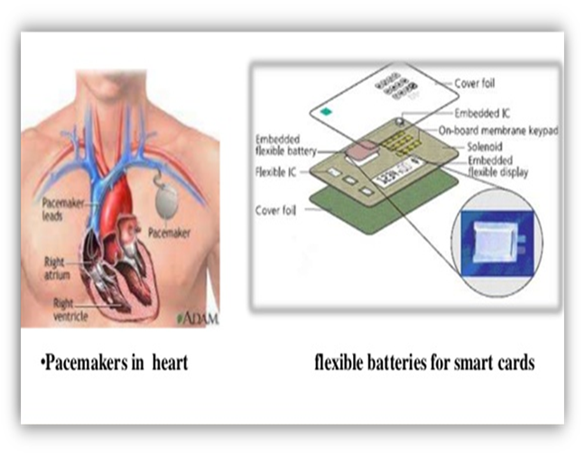
Applications:
Use as Pacemakers in heart.
Use in smart cards, Smart toys, smart clothes, children sound books, talking posters.

Slide 31
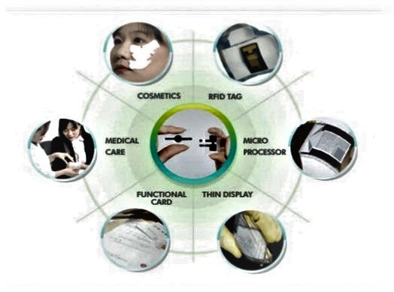
Use in RFID tags.
Use as alternate to conventional batteries in gadgets.
It uses for portable electronics,
aircraft, automobiles.

Slide 32
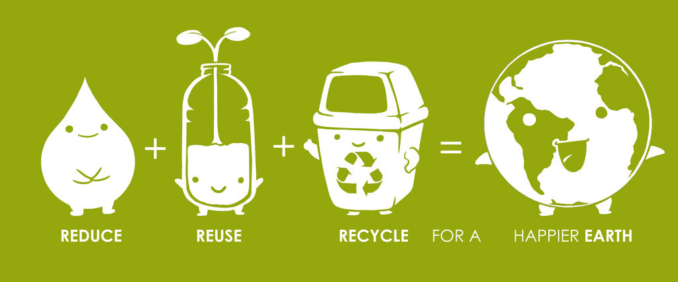
Think Outside the Trash!
Make a Difference in This World
Reuse Reduce Recycle

Slide 33
Contents:
Introduction
Principles
Applications
Advantages
Disadvantages
Future aspects
References

Slide 34
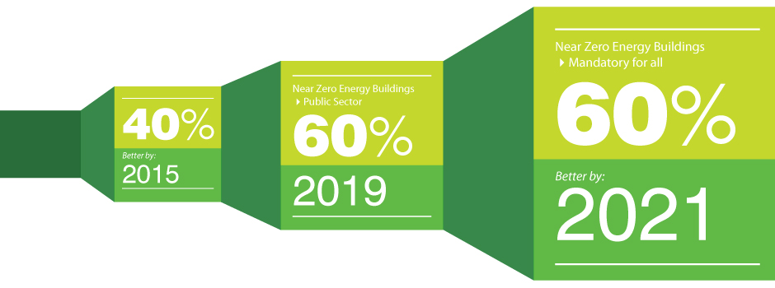
Zero Energy Building
Increased comfort.
Reduced total net monthly cost
of living.
Provide 25-year warranties.
contribute to the greater benefits
of the society by providing sustainable renewable energy.
Advantages:

Slide 35
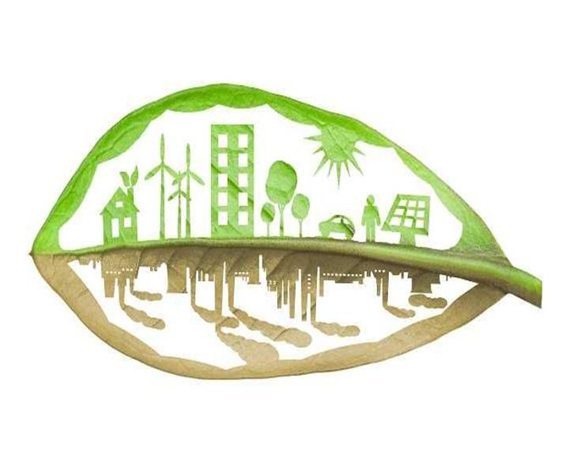
Disadvantages:
Initial costs can be higher.
Very few designers or builders have the necessary skills or experience to build ZEBs.
New energy rating systems are being introduced.
Solar energy capture is only applicable for sun prone area.
These buildings need solar energy.

Slide 36

Future Aspects:
With the advancement in renewable technology Zero Energy Buildings are the future.
But goal of ZEBs would not be fulfilled unless people don't understand their contribution towards reducing energy consumption.

Slide 37
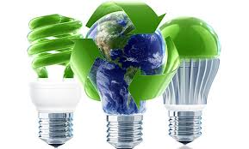
LED Lighting for Energy Efficiency
Advantages:
LED lights do not contain any hazardous materials. Therefore do not generate any hazardous waste.
LED lights are much easier on eyes than other lights.
Tremendous energy saving up to 90%.
LED lights can be recycled.

Slide 38
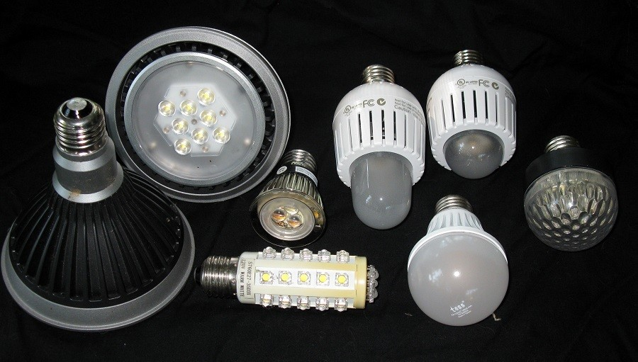
Disadvantages:
Initial cost of LED light system is high.
LED performance largely depends on the ambient temperature of the operating environment.
LEDs are much more attractive to insects than other lights.
Shift color due to age and temperature.

Slide 39
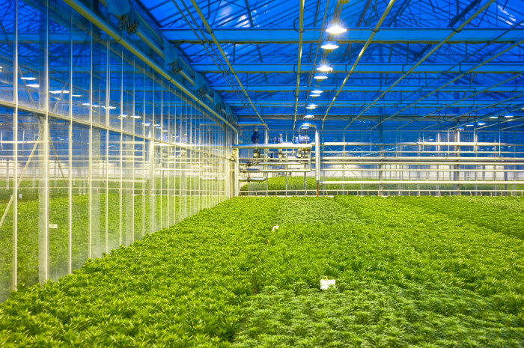
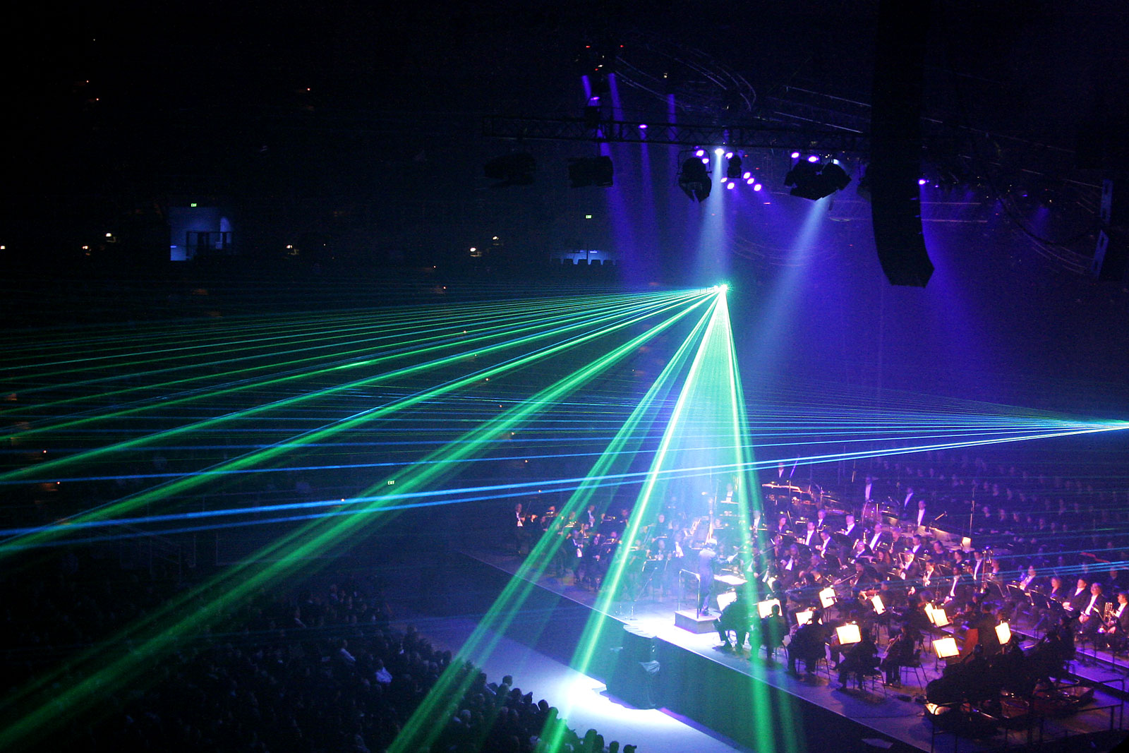
Future Aspects:
LED technology can have an enormous impact on agriculture.
LED lights are now using for decorating stages.
According to the U.S. Department of Energy (DOE). By 2030, 84 percent of all lighting applications are expected to be LED.

Slide 40
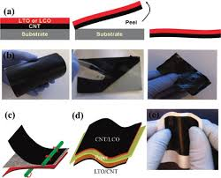
Paper Battery
Advantages:
Very light weight and flexible.
It can be fold twisted or cut into
numerous shapes.
Biodegradable and non-toxic.
Durable and rechargeable.
Reusable and recyclable.
It can be a super capacitor.

Slide 41
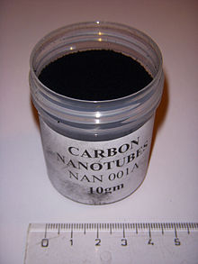
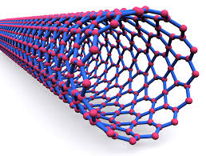
Disadvantages:
Carbon Nano tubes are very expensive.
Batteries with large amount of
power are cost effective.
Replacing the old batteries
results wastages.

Slide 42
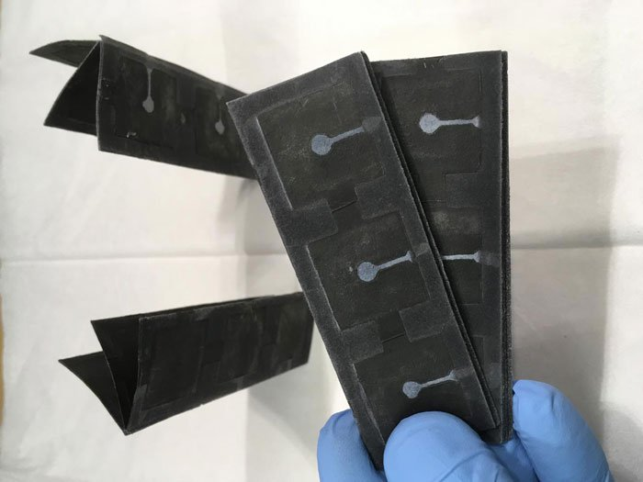
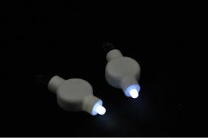
Future Aspects:
This black paper battery can power a small light.
The ambition is to procedure the reams of paper that could one day power a car.

Slide 43
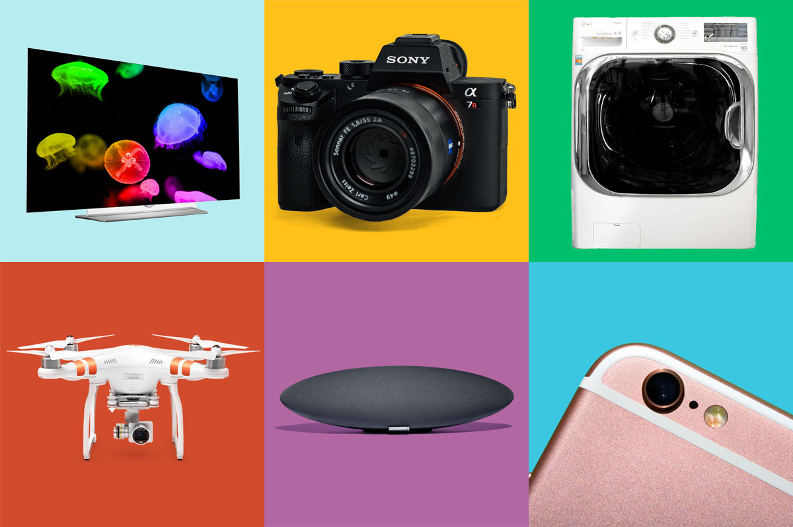
This Flexible paper battery could meet the energy demands of the next generation of gadgets.

Slide 44
References:
Wikipedia
Link: https://www.wikipedia.org
Slide share
Link: https://www.slideshare.net
El.Pro.Cus
Link: https://www.elprocus.com
Energy.Gov
Link: https://www.energy.gov/
Zero energy project
Link: https://zeroenergyproject.org/

Slide 45
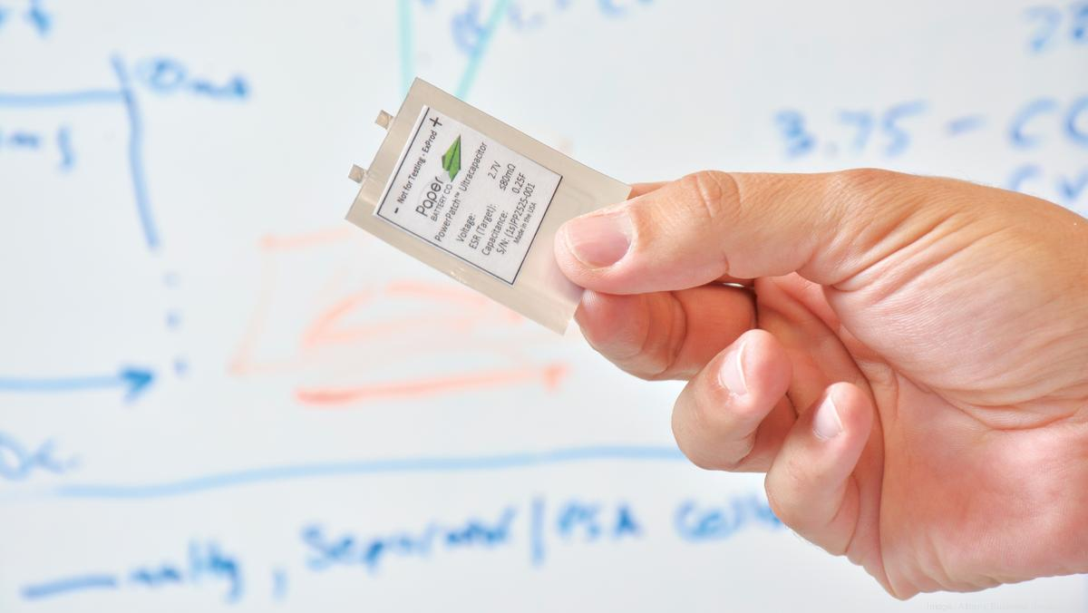
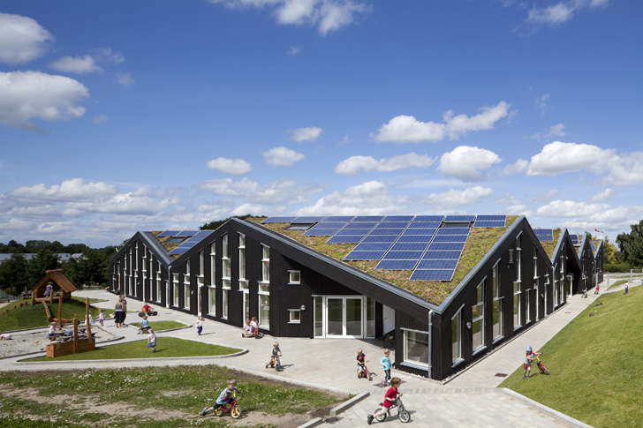
Green Energy
Paper Battery
Zero Energy Building

Slide 46

People who are crazy enough to think they can change the world are the ones who do.

Slide 47
Thank You!

